Slide 1


Personal Finance Management
Supervisor: Mr. Nguyễn Văn Hiển
Team member:
1. Lại Lê Lệ Linh
2. Nguyễn Thị Gấm
3. Lê Thị Minh Khánh
4. Nguyễn Đức Lộc
5. Nguyễn Anh Tuấn

Slide 2

Content
Introduction
Project Management Plan
Requirement Specification
Design Description
Implementation
Test Document
Summary
Demo and Q&A

Slide 3
Introduction
The people
Initial idea
Overview of existing systems
Our proposal

Slide 4
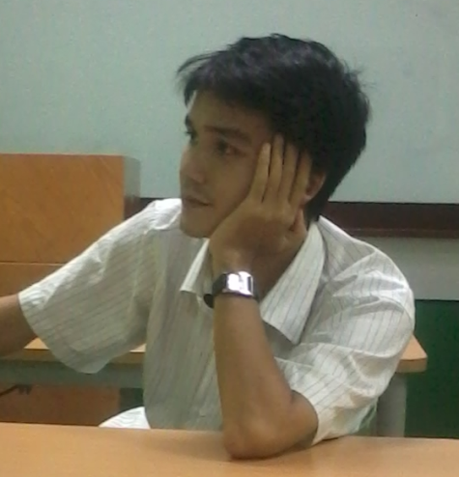
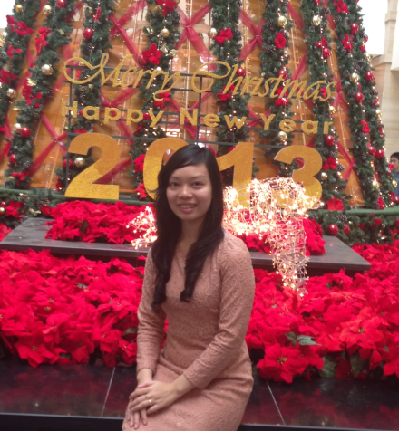
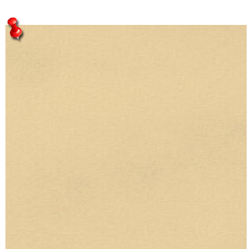
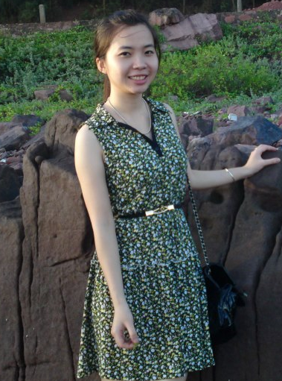
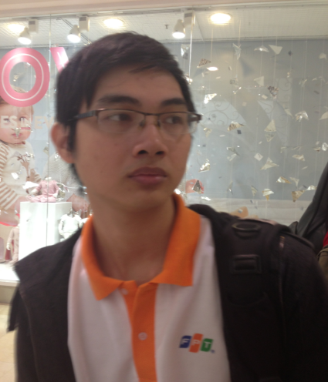

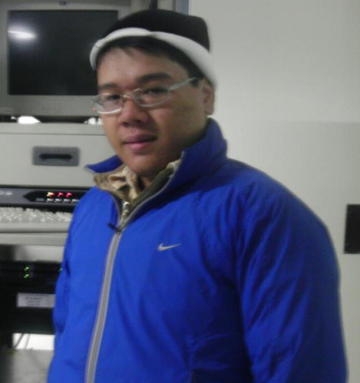
Lại Lê Lệ Linh
The people
Project Leader
Tester
Designer
Instructor
Tester
Mr. Nguyễn Văn Hiển
Lê Thị Minh Khánh
Tester
Technical Leader
Developer
Developer
Nguyễn Thị Gấm
Nguyễn Đức Lộc
Nguyễn Anh Tuấn

Slide 5
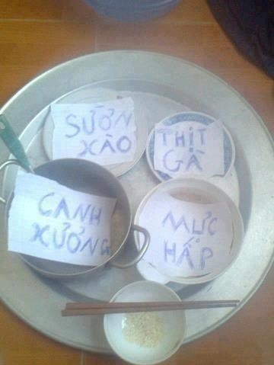


Initial Idea
Some people can not manage their money
Notes:
Tại sao ko quản lý đc
Ví dụ
Dẫn chứng một số ứng dụng đã có và không đáp ứng đc nhu cầu

Slide 6



Overview of existing systems
Money Lover
CWMoney
Easy Money

Slide 7
Overview – Money Lover
1
Difficult to access application
2
Not user - friendly
3
No synchronization between different units
Money Lover
Notes:
Lúc mới vào app phải seetting ngôn ngữ và account

Slide 8
Overview - CWMoney
1
Not support Vietnamese
2
Not enough function to manage finance
3
Difficult to use
CWMoney

Slide 9
Overview – Easy Money
1
Lost data
2
Must buy to use
3
Very confuse
Easy Money

Slide 10

Our proposal
Interface
User- friendly
Functions
Schedule: User can create schedule follow week or month
Elegant
Income and Expense Management: helps user manage income and expense every month. In this function, user can input data faster by using NFC and Q code
Borrowing and Lending: user can input interest to calculator the debts and loans.
Warning: reminder user when expenses exceed plan or the maturity of borrowing or lending
Import & Export: all users’ data will be export to excel file which user can see without application access
Use Vietnamese
Synchronize: help user storage data

Slide 11


Project Management Plan
Development Environment
Process
Project Organization
Project Plan

Slide 12

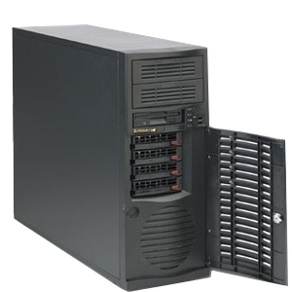
Development Environment
Development Hardware
3 Gb of RAM
Server Hardware
Core i4 Duo 2.0 Ghz
300Gb of hard disk
3 Gb of RAM
300Gb of hard disk
Core i4 Duo 2.0 Ghz

Slide 13







Development Environment

Slide 14
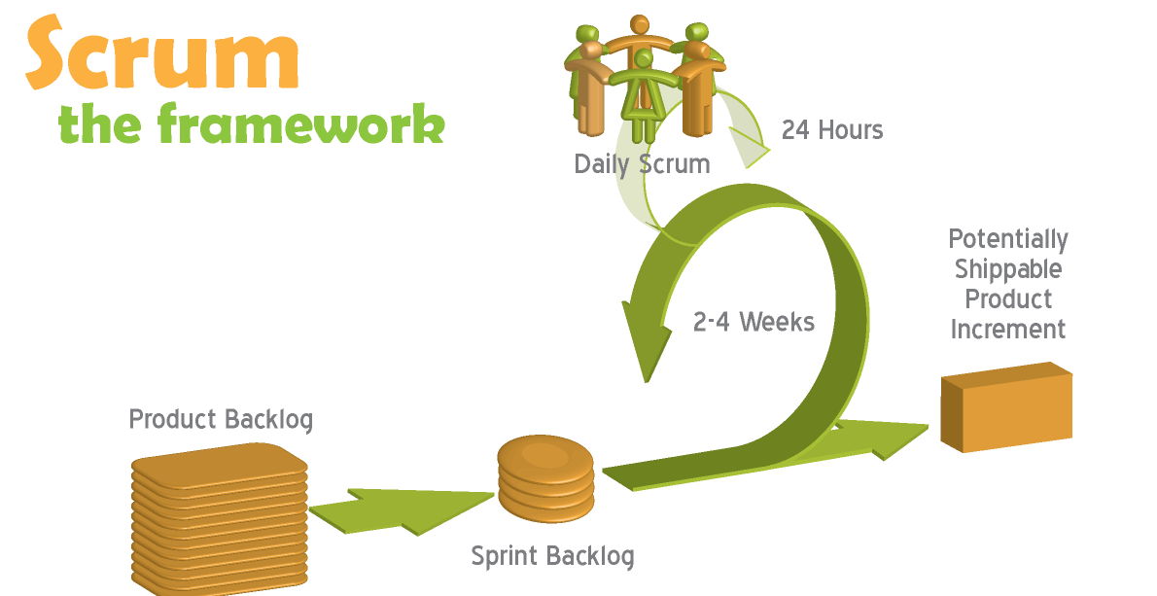
Process
Follow Scrum Model

Slide 15
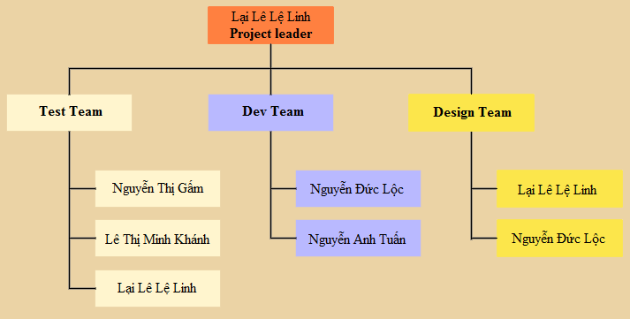
Project Organization

Slide 16
Project Plan
PFM
Communication
Meeting, Email, Skype, Hangout…
Time
Follow Capstone Project Requirements
Buffer: 10 days
Weekly Meeting
Checking progress
Require: Instructor and all team members.
Data
Upload and download all project document from SVN: https://piem2012.googlecode.com/svns

Slide 17
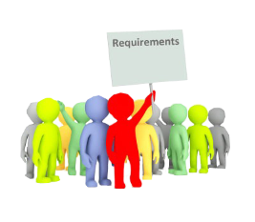

Software Requirement Specification
Functional Requirement
Non- functional Requirement

Slide 18
Functional Requirement
Management
Record all transactions (expense, income…)
Edit all transactions, warnings…
Setup warning
Track
View all transactions, warnings…
View statistics report
Synchronize data

Slide 19


Non-functional Requirement
GUI: elegant, simple, outstanding
Availability
Run 24/7
Portability
Have work on Android 2.3 and higher
Usability
Maintainability
Performance
Easy to install
Following coding standard and naming convention
Loading time: 1 second

Slide 20
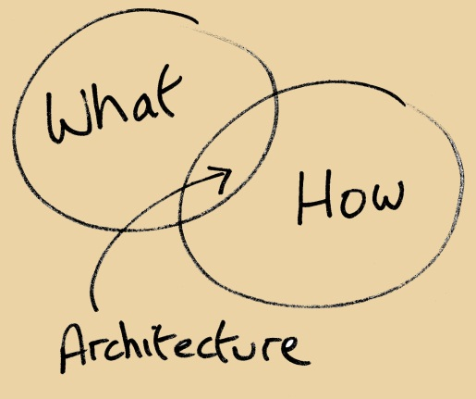

Software Design Description
Architectural Design
Detailed Design
Database Design

Slide 21
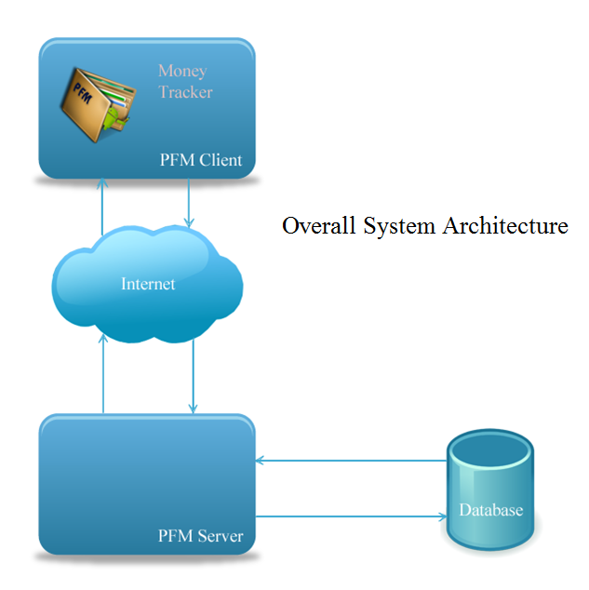
Architectural Design

Slide 22
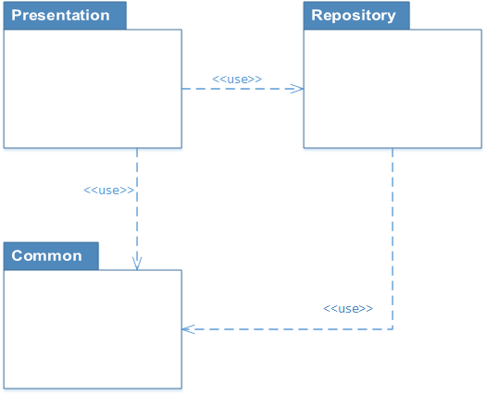
Detailed Design
Package Diagram

Slide 23
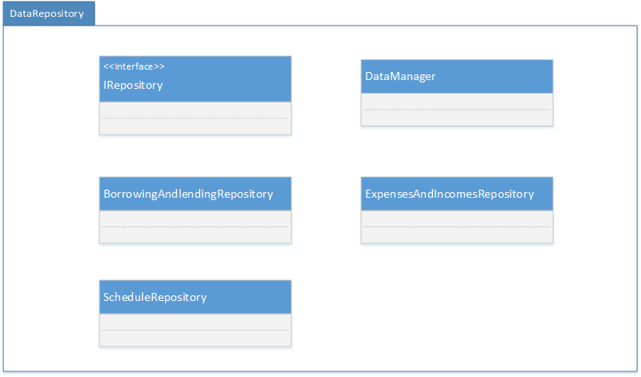
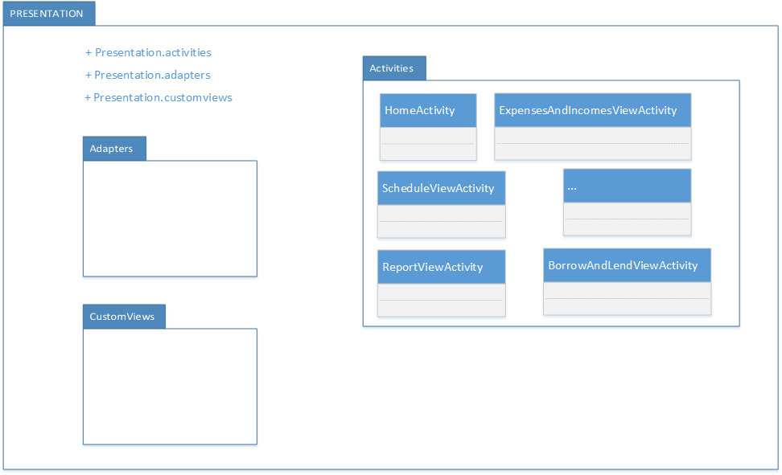
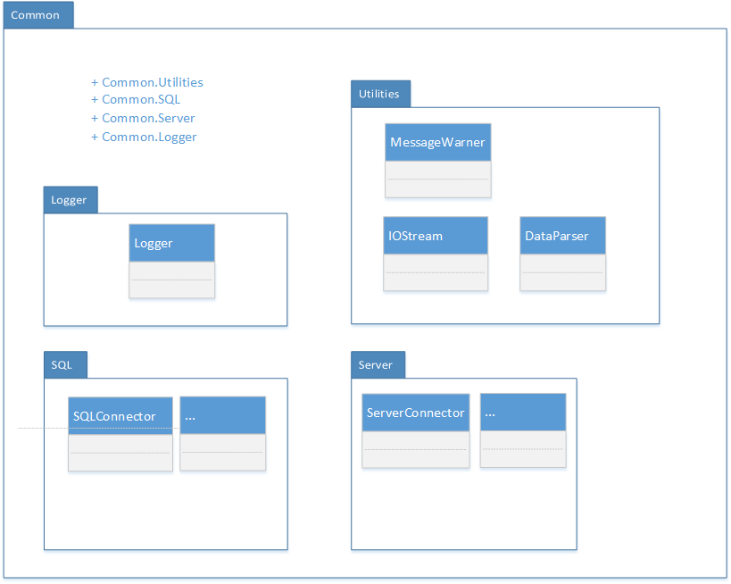
Detailed Design

Slide 24
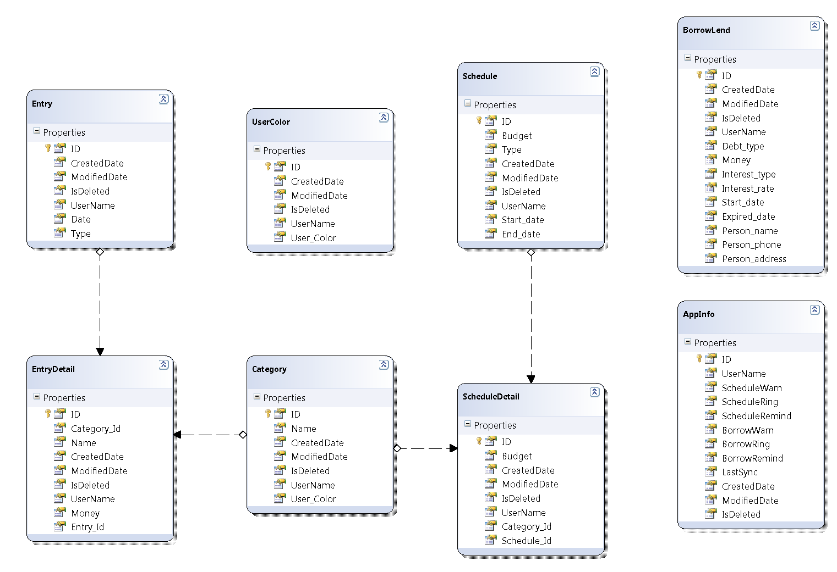
Database Design - Client

Slide 25
Technology Solution
Near Field Communication(NFC)
Synchronization
Quick Response Code

Slide 26

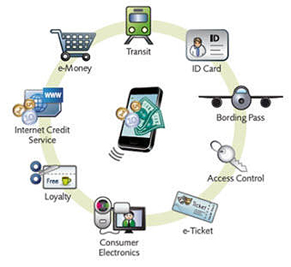
Near Field Communication (NFC)
A set of standards to establish radio communication
A set of standards to establish radio communication

Slide 27
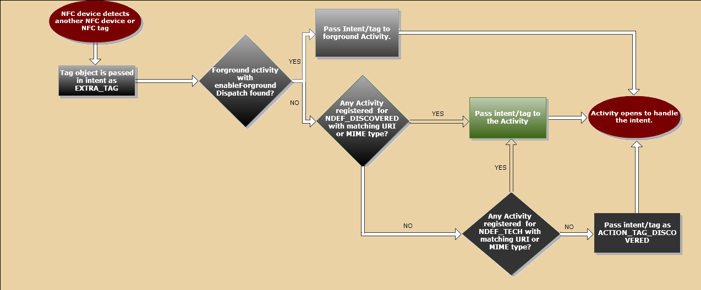
Near Field Communication (NFC)

Slide 28
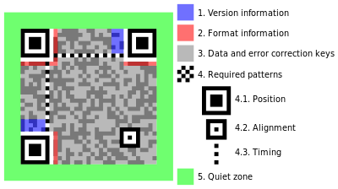
Quick Response Code (QR Code)
What is QR Code?
the trademark for a type of matrix barcode
invented in Japan by the Toyota subsidiary Denso Wave in 1994

Slide 29
Zxing in Money Tracker
2. QR Detector
for (long i = 0; i < dimension; ++i) // y-axis direction { for (long j = 0; j < dimension; ++j) // x-axis direction { // The QR code is read as if it were an un-rotated and un-skewed image POINT pt; pt.x = (j * module_size) + half_module_size; pt.y = (i * module_size) + half_module_size; POINT p = transform.TransformPoint(pt); // Does the perspective correcting qr_store.set(pt, image.IS_BLACK(p)); } }

Slide 30
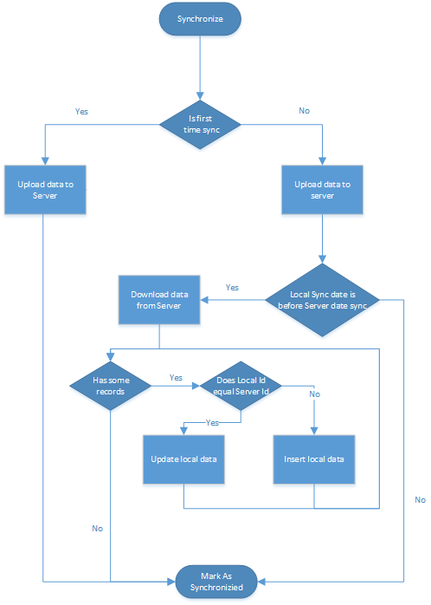
Synchronization
Synchronize all user’s data with an existed email account
Synchronize data with multi-account
Synchronize data to multi-device
Automatically synchronization mode

Slide 31
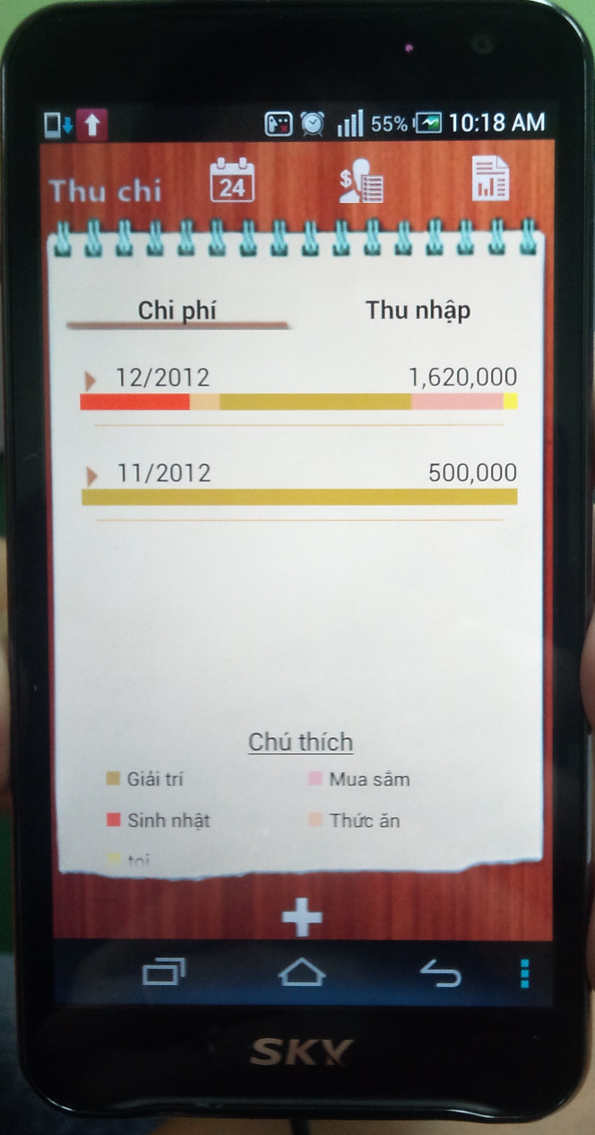
Software Test Document
Feature to be tested:
User Interface
Functional

Slide 32
Test Report
 | Pass | Fail | Untested | Accepted | N/A | Number of Test cases
Test Pass 1 | 98 | 47 | 0 | 0 | 0 | 145
Function-Use case | 60 | 46 | 0 | 0 | 0 | 106
GUI | 32 | 0 | 0 | 0 | 0 | 32
Common | 6 | 1 | 0 | 0 | 0 | 7
Test coverage
Test coverage |  |  |  |  |  | 100.00%
Test successful coverage |  |  |  |  |  | 67.58%

Slide 33
Test Report
 | Pass | Fail | Untested | Accepted | N/A | Number of Test cases
Test Pass 2 | 145 | 0 | 0 | 0 | 0 | 145
Function-Use case | 106 | 0 | 0 | 0 | 0 | 106
GUI | 32 | 0 | 0 | 0 | 0 | 32
Common | 7 | 0 | 0 | 0 | 0 | 7
Test coverage
Test coverage |  |  |  |  |  | 100.00%
Test successful coverage |  |  |  |  |  | 100.00%

Slide 34



Lesson Learnt
Improved working in group, presentation, communication skill
Work well under higher pressure
More work experience with tools and technic like: android, photoshop, NFC…

Slide 35

Thank for Listening

Slide 36
Demo

Slide 37
Q&A

